Slide 1
Deadlocks, starvation, race conditions and Global Interpreter Lock (GIL)

Slide 2
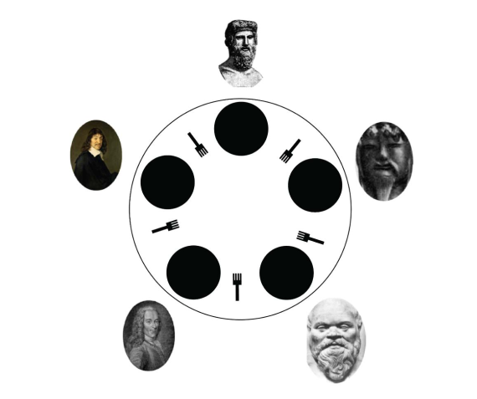
Deadlocks
A deadlock refers to a specific situation in which no progress can be made, and the program becomes locked in its current state;
Deadlocks are mostly caused by a lack of, or mishandled, coordination between different lock objects;
An example: the dining philosophers problem.
Notes:
Given a concurrent program with multiple threads or processes, the execution flow
enters a deadlock if a process (or thread) is waiting on a resource that is being held and
utilized by another process, which is, in turn, waiting for another resource that is held
by a different process. In other words, processes cannot proceed with their execution
instructions while waiting for resources that can only be released after the execution is
completed; therefore, these processes are unable to change their execution states

Slide 3
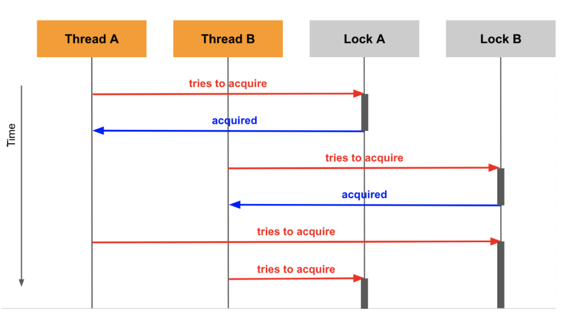
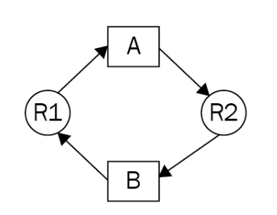
Deadlocks
Coffman conditions.
Mutual exclusion;
Hold and wait;
No preemption condition;
Circular wait.
Notes:
Example 1

Slide 4
Deadlocks
How to avoid deadlocks
Implementing ranking among resources:
No ordering in accessing resources causes circular wait.
Drawback: concurrent processes may turn out to be executed sequentially.
Ignoring locks and sharing resources;
Eliminating the ‘mutual exclusion’ condition.
Locks do not lock anything. They are not connected to the resources and are simply flags in the process to check whether a resource should be accessed.
Check if the problem needs to be solve in a concurrent way.
Livelock:
Processes (or threads) switch states back and forth infinitely and no progress is made.
Notes:
We will be using the built-in id()
function in Python here, which returns the unique, constant identity of the parameter,
as the keys to sort the lock objects. We will also implement a custom context manager to
factor out this sorting logic in a separate class.
removing any locking mechanisms in a concurrent program means that the likelihood of
the shared resources, which are now free from access limitations, being manipulated in an
uncoordinated way (and therefore, becoming corrupted) increases significantly.

Slide 5
Starvation
Starvation is a problem in concurrent systems, in which a process (or a thread) cannot gain access to the necessary resources in order to proceed with its execution and, therefore, cannot make any progress.
Causes of starvation:
Priority between process and poorly coordinated set of scheduling instructions:
Processes with higher priority dominate the execution flow in the CPU or the usage of non-sharable resources;
Processes with lower priority are waiting for resources, but as soon as the resources become available, other processes/threads immediately utilise the freed resources.
Priority inversion:
Processes with higher priority will not be able to complete, if it depends on the completion of processes with lower priority and that process is in starvation state.
Links to deadlocks:
In deadlocks, processes are in starvation state.
Notes:
Processes with lower priority do not have chance to access resources to proceed.

Slide 6
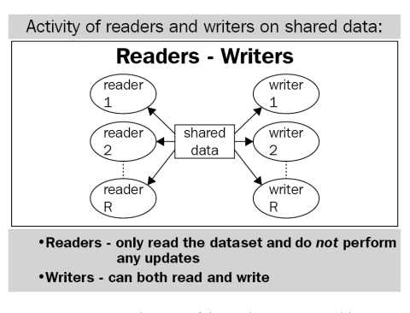
Starvation
Readers-Writers problem:
If a process is writing data to the file, no process should access the file.
The goal is to correctly and efficiently coordinate readers and writers.
Solutions
Reader preference -> writer starved;
Writer preference -> reader starved;
Service lock.

Slide 7
Starvation
How to avoid starvation
Increasing the priority of low-priority threads:
First-in-first-out thread queue:
Balance the selection frequency of different threads, for example a priority queue gives gradually increasing priority to threads that have been waiting in the queue for a long time or giving less priority to thread which has been access the shared resources many times:

Slide 8
Race conditions
A race condition is defined as a phenomenon during which the output of a system is both indeterminate and dependent on the scheduling algorithm and the order in which tasks are scheduled and executed;
Critical sections indicate shared resources that are accessed by multiple processes/threads.
Data in critical sections can be mishandled or corrupted when interacted and altered in parallel.
The logical solution is to not allow multiple process go into a critical section at the same time.

Slide 9
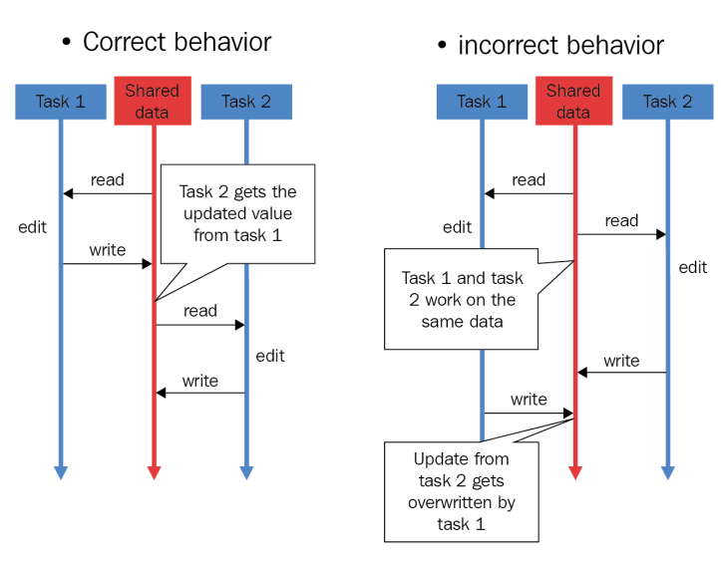
Race conditions

Slide 10
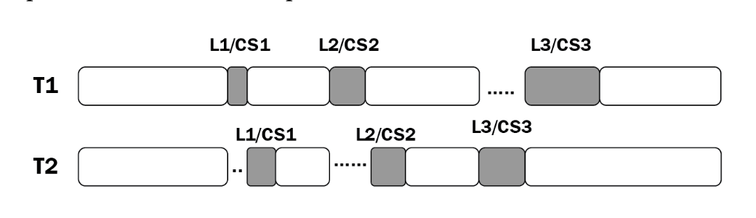
Race conditions
Ensure mutual exclusion by locks
Drawbacks:
Processes are executed sequentially.
Locks do not lock anything:
Lock acquiring and releasing is not controlled by the resource.
Race conditions in real life
Security
Race conditions occur when data is altered between Time of check and time of use in authentication system;
Random output caused by race conditions can be used to create digital fingerprints.
Networking;
Two users request admin access at the same time.
Operating system:
Stacks of execution of two processes overlap;
mkdir command in unix (mknod + chown)

Slide 11
Global Interpreter Lock (GIL)
GIL:
Designed as a lock that will only allow one thread to access and control the Python interpreter at any given time;
GIL must firstly be acquired by any python instruction to be executed (CPU-bound tasks);
It prevents multithreaded programs from reaching their fully optimised speed.
Why GIL is implemented:
Related to python memory management:
A variable is simply a name, rather than an actual location the in the memory where a value is written;
When a value is assigned to a variable, the variable is given a reference to the location of the value;
Reference to a given value constantly changes and reference count needs to be tracked.
What GIL solves:
The reference count is a shared resource (critical section). GIL prevents a race condition from occuring for any reference count.

Slide 12
Global Interpreter Lock (GIL)
Problems raised by GIL
A concurrent program will not be able to be fully multithreading.
Working with GIL
Use multiprocessing rather than multithreading;
Bypass GIL using native extension like numpy;
Use different python interpreter like Jython and IronPython.

